Slide 1
Chapter 3: Process Synchronization
Prepared by
Abdul Quyoom
Assistant Professor
Department of CSE
Lovely Professional University
Notes:
1

Slide 2
Process Synchronization
It is the coordination of execution of multiple processes in a multi-process system to ensure that they access shared resources in a controlled and predictable manner.
It aims to resolve the problem of race conditions and other synchronization issues in a concurrent system.
The main objective is to ensure that multiple processes access shared resources without interfering with each other, and
To prevent the possibility of inconsistent data due to concurrent access.
Example:
A process P1 tries changing data in a particular memory location at the same time another process P2 tries reading data from the same memory location.

Slide 3
Background
Process Synchronization is a technique which is used to coordinate the process that use shared Data.
There are two types of Processes in an Operating Systems:-
Independent Process – The process that does not affect or is affected by the other process while its execution then the process is called Independent Process.
Example The process that does not share any shared variable, database, files, etc.
Cooperating Process – The process that affect or is affected by the other process while execution, is called a Cooperating Process.
Example The process that share file, variable, database, etc are the Cooperating Process.

Slide 4
Background
Co-Operating Process: that can affect or be affected by other processes executing in system
Concurrent access to shared data may result in data inconsistency.
Process Synchronization: process synchronization is to ensure that
Multiple processes access shared resources without interfering with each other, and
To prevent the possibility of inconsistent data due to concurrent access.
Process P1 Process P2
1. X=5
2. X=5+2 1. read(x);
2. x=x+5;
3. Printf( x);
Notes:
4

Slide 5
Problem arises not having synchronization between process
1. Race condition problem:-
When more than one process is executing the same code or accessing the same memory or any shared variable in that condition there is a possibility that the output or the value of the shared variable is wrong
so for that all the processes doing the race to say that my output is correct this condition known as a race condition.
2. Critical section problem :-
A critical section is a code segment that can be accessed by only one process at a time. E.g
The critical section contains shared variables that need to be synchronized to maintain the consistency of data variables.
So the critical section problem means designing a way for cooperative processes to access shared resources without creating data inconsistencies.

Slide 6
Race Condition
When multiple processes access and manipulate the same data at the same time, they may enter into a race condition.
Race Condition: When output of the process is dependent on the sequence of other processes.
Race Condition occurs when processes share same data
Process P1 Process P2
1. reads i=10
2. i=i+1 =11
1. P2 reads i=11 from memory 2. i=i+1 = 12
3. Stores i=11 in memory 3. Stores 12 in memory
Notes:
6

Slide 7
Critical Section Problem
If we remove the critical section,
we cannot guarantee the consistency of the end outcome after all the processes finish executing simultaneously.
A process is in the critical section, if it executes code that manipulate shared data and resources.
Each process should seek permission to enter its critical section
Entry Section
Exit Section
Remainder section: Contains remaining code
Notes:
7

Slide 8
Structure of a process
Locks are set here
Critical Section ( a section of code
where processes work with shared data)
Locks are released here
Repeat
{
// Entry Section
Critical Section
// Exit Section
Remainder Section
} until false.
Notes:
8

Slide 9
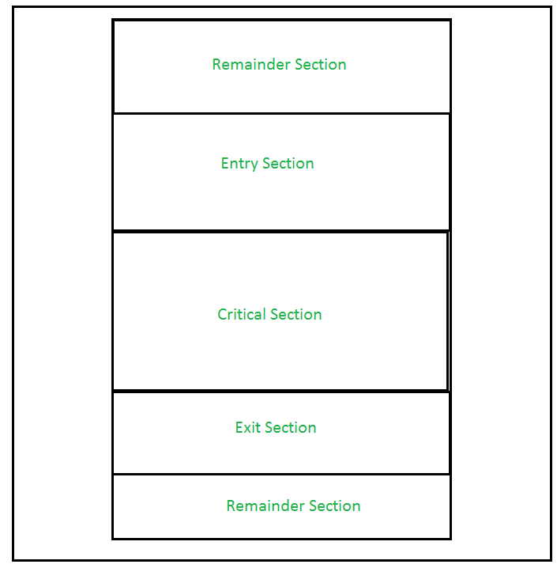

Slide 10
This setup can be defined in various regions like:
Entry Section – It is part of the process which decide the entry of a particular process in the Critical Section, out of many other processes.
Critical Section – It is the part in which only one process is allowed to enter and modify the shared variable.This part of the process ensures that only no other process can access the resource of shared data.
Exit Section – This process allows the other process that are waiting in the Entry Section, to enter into the Critical Sections.
It checks that a process that after a process has finished execution in Critical Section can be removed through this Exit Section.
Remainder Section – The other parts of the Code other than Entry Section, Critical Section and Exit Section are known as Remainder Section.

Slide 11
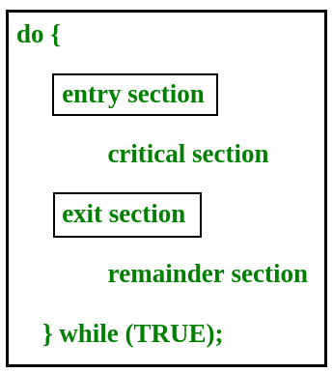
Structure of a process

Slide 12
Solution to Critical Section
Three essential rules that any critical section solution must follow are as follows:
Mutual Exclusion, Progress, No Starvation(Bounded waiting)
1. Mutual Exclusion: It states that if one process is executing in its critical section, then no other process can execute in its critical section.
2. Bounded Wait : It states that if a process makes a request to enter its critical section and before that request is granted, there is a limit on number of times other processes are allowed to enter that critical section.
3. Progress : No process running outside the critical section should block the other interested process entering into critical section when CS is free.
An upper bound must exist on the number of times a process enters
Notes:
12

Slide 13
Solutions
Software type
Lock variable
b. Peterson algorithm
OS type
Counting semaphore
Binary semaphore
Hardware type
Test and set lock
Programming compiler support type
a). Monitor

Slide 14
Problems
Deadlock:
When two or more processes wait for each other to release a critical section.
Deadlocks can be difficult to detect and resolve, and
they can have a significant impact on a program’s performance and reliability.
Starvation:
When a thread or process is repeatedly prevented from entering a critical section, it can result in starvation
Overhead:
When using critical sections, threads or processes must acquire and release locks or semaphores, which can take time and resources. This may reduce the program’s overall performance.

Slide 15
Producer Consumer Problem
It is a classical multi-process synchronization problem, that is we are trying to achieve synchronization between more than one process.
There is one Producer in the producer-consumer problem, Producer is producing some items, whereas there is one Consumer that is consuming the items produced by the Producer.
The same memory buffer is shared by both producers and consumers which is of fixed-size.
Task of the Producer is to produce the item & put it into the memory buffer, and again start producing items.
Whereas the task of the Consumer is to consume the item from the memory buffer.
Notes:
15

Slide 16
Producer Consumer Problem
Few points that considered as the problems occur in Producer-Consumer:
The producer should produce data only when the buffer is not full.
In case it is found that the buffer is full, the producer is not allowed to store any data into the memory buffer.
Data can only be consumed by the consumer if and only if the memory buffer is not empty.
In case it is found that the buffer is empty, the consumer is not allowed to use any data from the memory buffer.
Accessing memory buffer should not be allowed to producer and consumer at the same time.

Slide 17
Producer Consumer Problem
Case :: when Producer Produces Items at Fastest Rate Than Consumer Consumes:
If Producer produces items at fastest rate than Consumer consumes Then Some items will be lost.
Eg. Computer → Producer
Printer → Consumer
Notes:
17

Slide 18
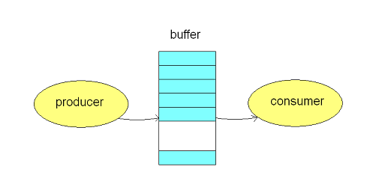
Producer Consumer Problem
Solution: To avoid mismatch of items Produced or Consumed
→ Take Buffer
Idea is: Instead of sending items from Producer to Consumer directly
→ Store items are placed into buffer
Notes:
18

Slide 19
Producer Consumer Problem
Buffer Can be:
1. Unbounderd Buffer:
No buffer size limit
Any no. of items can be stored
Producer can produce on any rate, there will always be space in buffer
2. Bounded Buffer:
Limited buffer size
Notes:
19

Slide 20
Producer Consumer Problem
Bounderd Buffer:
If rate of Production > rate of Consumption:
Some items will be unconsumed in buffer
If rate of Production < rate of Consumption:
After some time buffer will be empty
Notes:
20

Slide 21
Producer
int count=0;
void producer(void)
{
int itemp;
while (true) {
producer_item(itemp);
/* produce an item and put in itemp */
while (count == BUFFER_SIZE);
// do nothing
buffer [in] = itemp;
in = (in + 1) % BUFFER_SIZE;
count++;
}
Steps to produce an item
1. Load Rp,M[count]
2. inc Rp
3. store M[count],Rp
Notes:
21

Slide 22
Consumer
void consumer(void)
{
int itemc;
while (true) {
while (count == 0); // buffer empty
// do nothing
itemc = buffer[out];
out = (out + 1) % BUFFER_SIZE;
count - - ;
process_item(itemc);
/* consume the item in nextConsumed
}
Steps followed for consumer
1. Load Rc,M[count]
2. Dec Rc
3. store M[count],Rc
Notes:
22

Slide 23
Peterson’s Solution
Two process solution (Software-based)
The two processes share two variables:
int turn;
Boolean flag[2]
The variable turn indicates whose turn it is to enter the critical section.
The flag array is used to indicate if a process is ready to enter the critical section.
flag[i]=true implies that, process P_{i} is ready!

Slide 24
Peterson’s Solution
The variable turn denotes whose turn it is to enter its critical section. I.e., if turn = = i,
then process Pi is allowed to execute in its critical section.
If a process is ready to enter its critical section, the flag array is used to indicate that.
E.g., if flag[i] is true, this value indicates that Pi is ready to enter its critical section.
To enter into the critical section, process Pi first sets flag[i] to be true and then sets turn to the value j, thereby asserting that if the other process wishes to enter the critical section, it can do so.
Turn will be set to both i and j at roughly the same time, if both processes try to enter at the same time.
The final value of turn determines which of the two processes is allowed to enter its critical section first.

Slide 25
Peterson’s Solution
Only 2 processes,
General structure of process P_{i} (other process P_{j})
do {
entry section
critical section
exit section
reminder section
} while (1);

Slide 26
Peterson’s Solution
do {
flag[i]=true;
Turn=j;
While(flag[j] && turn=j);
/* critical Section */
flag[i]=false;
/* Reminder Section */
}
While (true);

Slide 27
Peterson’s Solution
We now prove that this solution is correct. We need to show that −
Mutual exclusion is preserved.
The progress requirement is satisfied.
The bounded-waiting requirement is meet.

Slide 28
Disadvantages
Peterson’s solution works for two processes only,
but this solution is best scheme in user mode for critical section.
This solution is also a busy waiting solution so CPU time is wasted.
Busy-waiting so CPU time is wasted
Only 2 process are allowed

Slide 29
Critical Section Problem solution
Now prove that this solution is correct.
We need to show that:
Mutual exclusion is preserved.
The progress requirement is satisfied.
The bounded-waiting requirement is met.

Slide 30
Synchronization Hardware
Process synchronization problems occur when two processes running concurrently share the same data or same variable.
The value of that variable may not be updated correctly before its being used by a second process.
Such a condition is known as Race Around Condition.
There are some hardware solutions to this problem.
Lock and unlock
Test and set
swap
Notes:
30

Slide 31
Hardware Solution to C.S.
1. Interrupt Disabling
Process leaves control of CPU, when it is interrupted.
Solution is:
To have each process disable all interrupts just after entering to the critical section.
Re-enable interrupts after leaving critical section
Notes:
31

Slide 32
Hardware Solution to C.S.
Interrupt Disabling
Repeat
Disable interrupts
Critical Section
Enable interrupts
Remainder section
Untill true
Notes:
32

Slide 33
Lock and unlock
The shared variable is lock which is initialized to false.
TestAndSet(lock) algorithm works in this way – it always returns whatever value is sent to it and sets lock to true.
The first process will enter the critical section at once as TestAndSet(lock) will return false and it’ll break out of the while loop.
Mutual exclusion is ensured. The other processes cannot enter now as lock is set to true and so the while loop continues to be true.
Progress is also ensured. -Once the first process gets out of the critical section, lock is changed to false. So, now the other processes can enter one by one.
Bounded waiting is not ensured. However, after the first process, any process can go in. There is no queue maintained, so any new process that finds the lock to be false again can enter. So

Slide 34
Lock and unlock
Load Ri, M[lock] LOCK =0, CS is free
Compare Ri , #0 lock =1, CS is busy
JNZ to step 1 ME not satisfied
Store M[LOCK], #1
Critical Section
STORE M[LOCK], #0 # unlocking will happen

Slide 35
Test and set lock
The test and Set instruction is a hardware instruction used to synchronize access to shared recourses in a multi-threaded or multi-process environment.
It is used to implement lock to ensure that only one process/ thread can access a shared resouses at a time.
The operation is performed automatically, meaning that it cannot be interrupted or preempted by other process or threads.
The instruction tests a specific memory locations to see if it is set to a particular value and if it is sets the value to a new value.

Slide 36
Test and set
TSL= test and set lock
TSL register lock= copies the current values of the lock into register & store the value of 1 into the lock in a single atomic cycle without any preemption.
TSL Ri, M[lock]
Compare Ri, #0
JNZ to step 1
Critical Section
Store M[lock], #0

Slide 37
Synchronization Hardware
Having the support of some simple hardware instructions, the CS problem can be solved very easily and efficiently.
The CS problem occurs because the modification of a shared variable of a process may be interrupted.
Two common hardware instructions that execute atomically
Test-and-Set
Swap

Slide 38
Synchronization Hardware
Atomically swap two variables.
void Swap(boolean *a, boolean *b)
{
boolean temp
temp = *a;
*a = *b;
*b = temp;
}

Slide 39
Mutual Exclusion with Swap
Shared data (initialized to false): boolean lock; /* global variable
Process P_{i}
do {
key = true;
while (key = = true)
Swap(&lock, &key);
critical section
lock = false;
remainder section
}

Slide 40
Semaphore
Semaphore is an integer variable which is used in a mutual exclusion manner by various concurrent cooperative process in order to achieve synchronization.
Synchronization tool that maintains concurrency using variables
Semaphore S is a integer variable which
can take positive values including 0.
It is accessed from 2 operations which are wait() and signal().
Notes:
40

Slide 41
Operations On Semaphore:
Two tpyes of operation are performed on Semaphores
wait() or p() or down() and
signal() or v() or up() or release()
Wait Operation is also known as P() which means to test
Signal Operation is also known as V() which means to increment
Entry to C.S. is controlled by wait()
Exit from C.S. is signaled by signal()

Slide 42
Semaphore
Can only be accessed via two indivisible (atomic) operations and S=1
For critical Section problem semaphore value is always 1
P(S) and V(S):
Entry section
down(S))
{
While(S>=0);
S--;
}
up(s)
{
S=s+1
}
Notes:
42

Slide 43
Solution of CS problem using semaphore
Do
{
down(S)
Critical Section
up(s)
Remainder section
} while(True)

Slide 44
Semaphore
After performing down operation, if the process is not getting suspend then it is called successful down operation
If it is successful down operation then only process will continue further execution in the code.
If it is unsuccessful down operation then the process will not continue further execution in the code.
To avoid the problem of busy waiting the concept of semaphore will be used.

Slide 45
Semaphore as General Synchronization Tool
Types of Semaphores:
Counting semaphore – when integer value can be any non-negative value, can be incremented / decremented.
Binary semaphore -- A synchronization tool that
has two states (0 or 1) and
It is used to signal the availability of a resource
Also known as mutex locks
Notes:
45

Slide 46
Binary Semaphore
Down(s)
{
If(s.value == 1)
{
s.value=0
}
Else
{
Block the process and place its PCB in the suspended list
}

Slide 47
Binary semaphore
Up(s)
{
If(suspended list is empty)
s.value=1;
Else
{
Select a process from suspended list and wake up;
}
}

Slide 48
Counting Semaphore
Counting Semaphore − Counting semaphore is a synchronization tool that is used in operating systems to control the access to shared resources.
It is a type of semaphore that allows more than two processes to access the shared resource at the same time.
A counting semaphore is represented by an integer value that can be incremented or decremented by the processes.
The key difference between binary and counting semaphores is that
binary semaphores can only take on two values, indicating either that a resource is available or unavailable,
while counting semaphores can take on multiple values, indicating the number of available resources.

Slide 49
Counting Semaphore
In modern operating systems, multiple processes may need to access the same resource simultaneously.
Without proper synchronization mechanisms, conflicts and race conditions can arise, leading to incorrect results or system failures.
Counting semaphore ensue that multiple processes can safely access shared resources in a coordinated and efficient manner.
It helps to prevent deadlocks, ensures mutual exclusion, and enhances system performance by minimizing the waiting time of processes.
Counting semaphore is used to solve problems like producer-consumer problem or the dining philosopher problem.

Slide 50
Counting semaphore
The positive value of counting semaphore indicates number of successful down operation we can perform.
The negative value of counting semaphore indicates number of process blocked
The down operation in the binary operation will be successful only if the initial value of s=1.
The down operation of counting semaphore will be successful only if the initial value of semaphore is greater than equal to 1.
If more than one process is in suspended list than every time when we perform one operation & one process will be wake up from suspended list based on FIFO.ss

Slide 51
Counting semaphore
Down (S)
{
s.value = s.value - 1;
If(s.value<0)
{
Block the process and place its in the PCB in the suspend list
}
Else
Return 0;
}

Slide 52
Counting semaphore
Exit section
Up(s)
{
s.value = s.value+1;
If (s.value <= 0)
{
Select a process from suspend list and wakeup
}
}

Slide 53
Semaphore and Busy Waiting
Disadvantage of Semaphore: Busy Waiting
When a process is in C.S. and any other process that wants to enter C.S. loops continuously in entry section.
Priority inversion
Wastes CPU cycles
Semaphore that implements busy waiting is known as: Spin Lock
Notes:
53

Slide 54
Semaphore Implementation with no Busy waiting
With each semaphore there is an associated waiting queue.
Each entry in a waiting queue has two data items:
value (of type integer)
Pointer to next record in the list
Notes:
54

Slide 55
Semaphore Implementation with no Busy waiting
Instead of waiting, a process blocks itself.
Two operations:
Block – place the process invoking the operation on the waiting queue.
Wakeup – remove one of processes in the waiting queue and place it in the ready queue.
Notes:
55

Slide 56
Deadlock
A deadlock occurs when a process or thread enters a waiting state.
because a requested system resource is held by another waiting process.
If the process are not properly synchronized while sharing the common variable then it is also possible to deadlock.

Slide 57
Deadlocks and Starvation
The using of semaphores may cause deadlocks
Starvation – indefinite blocking of a low priority process.
A process may never be removed from the semaphore queue in which it is suspended
For example: waiting queues are implemented in LIFO order.
P₀
(Initially, A=B=1)
P₁
wait(B);
wait(A);
S₁
signal(B);
signal(A);
wait(A);
wait(B);
S₀
signal(A);
signal(B);
deadlock

Slide 58
Drawbacks of Semaphores
Semaphores provide a convenient and effective mechanism for process synchronization.
However, incorrect use may result in timing errors.
signal(mutex);
...
critical section
...
wait(mutex);
wait(mutex);
...
critical section
...
incorrect order
(not mutual exclusive)
forgotten
...
critical section
...
signal(mutex);
wait(mutex);
...
critical section
...
wait(mutex);
typing error
(deadlock)

Slide 59
Question
Question : Consider a system where the initial value of counting semaphore is 17 then various semaphore operations like 23p,14v,16p,9v,3p are performed then what is the final value of counting semaphore?
Answer
S = 17 -23+14-16+9-3
= -2

Slide 60
Question
Question Consider a counting semaphore variable S, the various semaphore operations like 20p,12v are performed then what is the largest initial value of semaphore S so that atleast one process will remain in the suspended list?
Solution : -1 = x- 20 + 12
X= 7

Slide 61
Classical Problems of Synchronization
Readers and Writers Problem
Dining-Philosophers Problem
Bounded-Buffer Problem
Notes:
61

Slide 62
Readers-Writers Problem
The readers-writers problem is a classical problem of process synchronization, it relates to a data set such as a file that is shared between more than one process at a time.
A data set is shared among a number of concurrent processes
Readers – only read the data set; they do not perform any updates
Writers – can both read and write.
Problem – allow multiple readers to read at the same time. Only one single writer can access the shared data at the same time.
Shared Data
Data set
For Readers: Semaphore mutex initialized to 1.
For Writers: Semaphore wrt in db initialized to 1.
Integer readcount initialized to 0.
Notes:
62

Slide 63
Readers and Writers Problem
Suppose that a database is to be shared among several concurrent processes.
Some of these processes may want only to read the database, whereas others may want to update (that is, to read and write) the database.
We distinguish between these two types of processes by referring to the former as readers and to the latter as writers.
Precisely in OS we call this situation as the readers-writers problem.
Problem parameters: One set of data is shared among a number of processes.
Once a writer is ready, it performs its write. Only one writer may write at a time.
If a process is writing, no other process can read it.
If at least one reader is reading, no other process can write.
Readers may not write and only read.

Slide 64
Readers-Writers Problem (Cont.)
The structure of a reader process
int rc=0; 4 condition used
Semaphore mutex = 1; read-read
Semaphore db = 1; read-write *
Void reader(void) write-read *
{ write-write *
While (true)
{
Down(mutex);
Rc = rc + 1;
If( rc == 1)
down(db);
Up(mutex);
}
Notes:
64

Slide 65
Cont..
Down(mutex);
Rc= rc -1;
If(rc == 0)
Up( db);
Up( mutex);
}
}

Slide 66
Structure of writer
Void writer(void)
{
While(true)
{
Down(db);
DB
Up(db);
}

Slide 67
Terminology used
Rc is a integer variable represent number of readers present in the database at any point of time
Mutex is a binary semaphore used by the readers in a ME manner.
Db is a binary semaphore variable used by readers and writer in a ME manner.

Slide 68
Conti ..
reader
first-in
writer
wait(mutex);
readcount++;
if (readcount == 1) wait(wrt);
signal(mutex);
...
reading is performed
...
wait(mutex);
readcount--;
if (readcount == 0) signal(wrt);
signal(mutex);
wait(wrt);
...
writing is performed
...
signal(wrt);
update
readcount

Slide 69
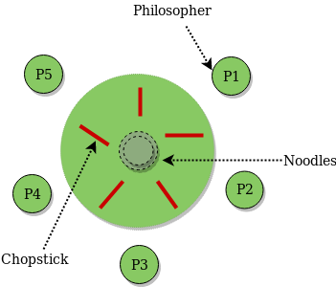
Dining Philosopher Problem
The Dining Philosopher Problem states that K philosophers are seated around a circular table with one chopstick between each pair of philosophers.
There is one chopstick between each philosopher.
A philosopher may eat if he can pick up the two chopsticks adjacent to him.
One chopstick may be picked up by any one of its adjacent followers but not both.
There are 3 states of the philosopher:
THINKING, HUNGRY, and EATING

Slide 70
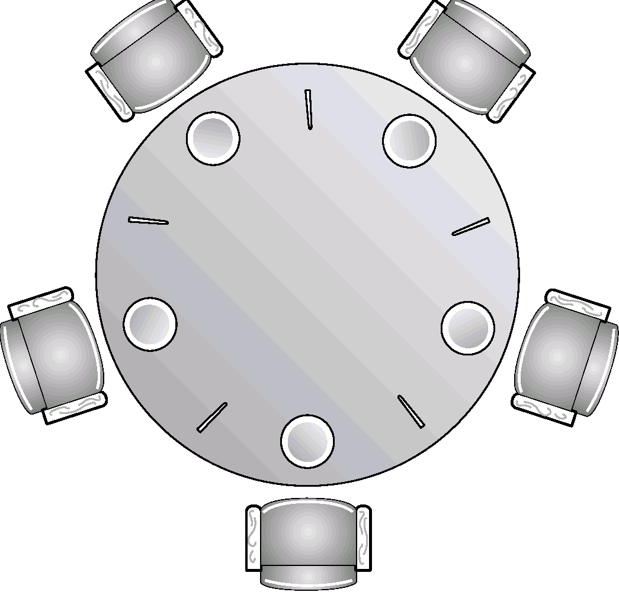
Dining-Philosophers Problem
There are Five philosophers,
They are either thinking or eating
to eat, two chopsticks are required
taking one chopstick at a time
Shared data
semaphore chopstick[5];
Initially all values are 1
3
3
2
4
2
4
1
5
1
5

Slide 71
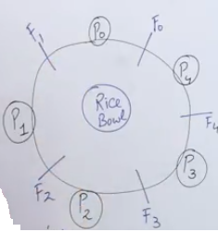
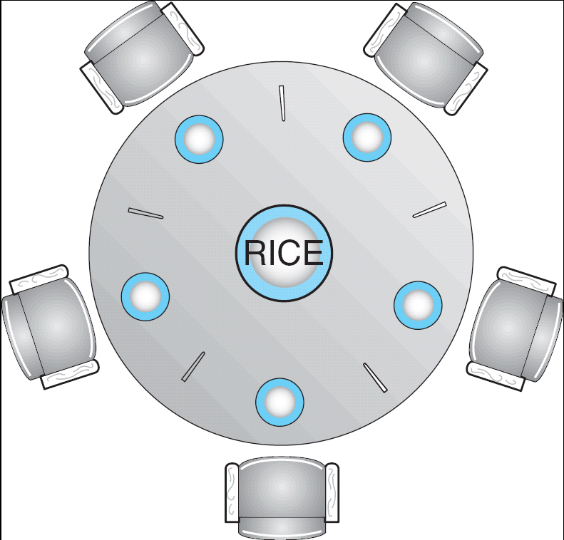
Dining-Philosophers Problem
Notes:
71

Slide 72
Dining philospher problem
Void philospher(void)
{
While(true)
{
Thnking();
Take_fork(i); take left fork
Take_fork((i+1)%N); take right fork , N-is number of forks
EAT();
Put_fork(i);
Put_fork((i+1)%N;
}

Slide 73
Dining philospher
If all the philosophers are hungry at the same time then everybody take left fork first and when they try to attempt to take right fork.
then nobody will get the right fork and all the philospher will wait on each other and they will go into deadlock.

Slide 74
Dining-Philosophers Problem
philosopher i
get chopsticks
left
right
do {
wait(chopstick[i]);
wait(chopstick[(i+1) % 5]);
...
eat
...
signal(chopstick[i]);
signal (chopstick[(i+1) % 5]);
...
think
...
} while(1);
free chopsticks
left
right
deadlock !

Slide 75
Dining-Philosophers Problem
Possible solutions to the deadlock problem
Allow at most four philosophers to be sitting simultaneously at the table.
Allow a philosopher to pick up her chopsticks only if both chopsticks are available (note that she must pick them up in a critical section).
Use an asymmetric solution; that is,
odd philosopher: left first, and then right
an even philosopher: right first, and then left
Besides deadlock, any satisfactory solution to the DPP problem must avoid the problem of starvation.

Slide 76
Solution to Dining Philosophers using binary semaphore
The distribution of the chop-sticks is controlled by the monitor Dining Philosophers
Each philosopher ‘ i ’ invokes the operations pickup() and putdown() in the following sequence:
dp.pickup (i)
EAT
dp.putdown (i)
Notes:
76

Slide 77
Solution of dining philosopher problem
do
{
Wait(table_fork(Si))
Wait(table_fork(S(i+1)%n)), n- is no of forks
Eat();
Signal(table_fork(Si))
Signal(table_fork(S(i+1)%n)
}

Slide 78
Terminology/abrivations used
S[N] is an array of binary semaphore initially are all assigned to 1;
State[N] is an integer array used to keep track of every philospher state. Initially all the philospher will be in the thinking state
i - is a philospher number.

Slide 79
Bounded buffer problem
Assume that there are n buffers, each capable of holding a single item.
We use three semaphores:
empty and full to count the empty and full buffers and
Mutex to provide mutual exclusion for operations on the buffer pool.
A producer tries to insert data into an empty slot of the buffer.
A consumer tries to remove data from a filled slot in the buffer.
As you might have guessed by now, those two processes won't produce the expected output if they are being executed concurrently.
There needs to be a way to make the producer and consumer work in an independent manner.

Slide 80
Bounded buffer problem
do {
wait(empty);
// acquire lock
wait(mutex); /
* perform the item adition
Add item in the buffer
signal(mutex);
// increment 'full‘
signal(full);
} while(TRUE)
do {
wait(full);
// acquire the lock
wait(mutex);
/* perform the remove operation in a slot
signal(mutex);
// increment 'empty‘
signal(empty);
} while(TRUE);

Slide 81
ALGORITHM | Mutual Exclusion | PROGRESS | WAITING BOUND
Peterson | Satisfied | Satisfied | Satisfied
Test and set | satisfied | satisfied | Not satisfied
Swap | Satisfied | Satisfied | Not satisfied
Lock variable | Not satisfied | Satisfied | Not satisfied
Readers and writers | Satisfied(writer) | Satisfied(writer) | Satisfied (writer)
Monitor
Dining philospher
Binary semaphore | Satisfied |  | May or may not
Counting semaphore | Not satisfied
Notes:
81

Slide 82
Precedence graph
it is a directed acyclic graph which is used to represent /show the execution level of several processes in operating system.
It consists of nodes and edges.
Nodes represent the processes and the
edges represent the flow of execution.
Any two statement Si and Sj can be executed concurrently or parallelly if they are following condition.
R(Si) intersection W(Sj)= phi
W(Si) intersection R(Sj)= phi
W(Si) intersection W(Sj)= phi

Slide 83
Conti….
Concurrent means, it has different meaning
They can execute concurrent or parallel.
They don’t have any dependency.
Anyone can start first.
Concurrent execution is performed by context switching.
Parllel execution is performed between multiple Processors.
Concurrent programming will be written by using
Parbegin – parend
Cobegin-coend

Slide 84
PARBEGIN/PAREND
PARBEGIN/PAREND statement is a higher-level language construct for specifying concurrency.
All statements can be executed concurrently those are enclosed between PARBEGIN and PAREND.
It is used in modelling precedence graph.
It is used as an alternative for the FORK/JOIN statement.
Note – PARBEGIN/PAREND is also called COBEGIN/COEND.

Slide 85
Concurent Programs
S0
PARBEEGIN;
S1;
S2;
…….
S(n-1)
PAREND;
Sn;

Slide 86
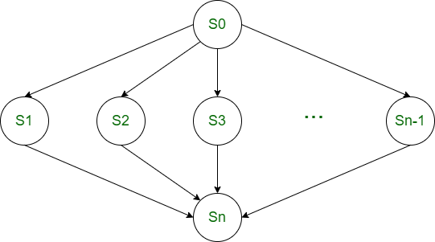
The above program is equivalent to the following precedence graph.

Slide 87
Question
Draw the precedence graph based on below mentioned statements?
S1: a=b+c;
S2: d=e*f;
S3: g=a/d;
S4=g*I;

Slide 88
Answer
S1
S2
S3
S4

Slide 89
Syntax of parbegin
Parbegin
S1;
S2;
S3;
parend
S1
S2
S3

Slide 90
Syntax of begin and end
Begin
S1;
S2;
S3;
end
s1
s2
s3

Slide 91
Question
s1
Par-begin
begin
S2;
S3;
end
begin
S4;
S5;
end
S6;
S7
Par-end
S8;

Slide 92
Monitor
Monitor is programming language compiler support type of solution to achieve synchronization.
It is alternate approach of semaphore to remove the race condition problem.
Monitor is collection of variable, condition variable and procedure combine together in a special kind of module or package.
The process running outside the monitor cannot directly access the internal variable of the monitor but however they can call procedure of the monitor.
Monitor has an important property that only one process can be active inside the monitor at a time and non preempt the process when the process enter into the monitor.

Slide 93
Monitors
A way to encapsulate the Critical Section by making class around the critical section and allowing only one process to be active in that class at one time.
The monitor type is a high-level synchronization construct.
Only one process may be active within the monitor at a time
Name of Monitor
Initialization Code Section
Procedure to request the Critical Data
Procedure to release the Critical Data
Notes:
93

Slide 94
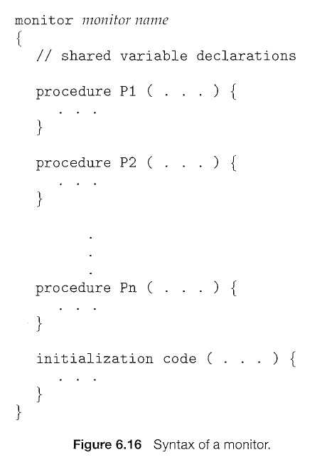

Slide 95
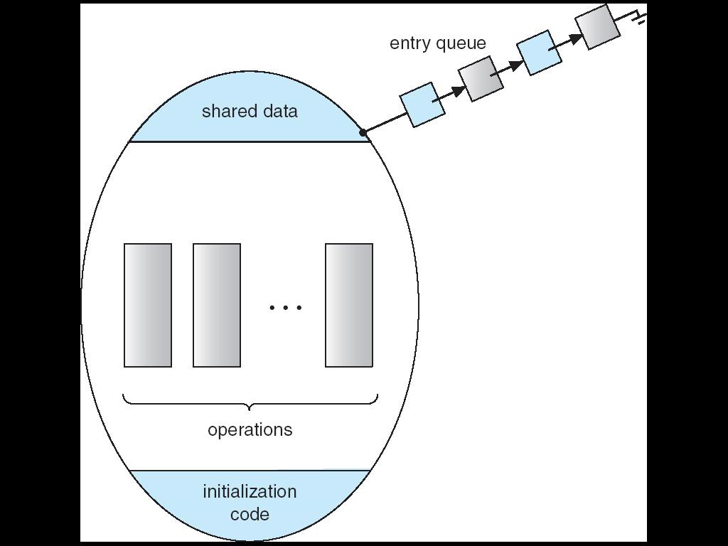
Schematic view of a Monitor
Only one process at a time can be in monitor
Notes:
95

Slide 96
Monitors
The monitor construct is not sufficiently powerful for modeling some synchronization schemes.
So, we need to define additional synchronization mechanisms.
These mechanisms are provided by the condition construct.
A programmer can define one or more variables of type condition:
condition x, y;
The only operations that can be invoked on a condition variable are wait () and signal().
Notes:
96

Slide 97
Condition Variables
Two operations on a condition variable:
x.wait () – a process that invokes the operation is suspended until another
process invokes x.signal()
x.signal () – resumes one of processes (if any) that invoked x.wait ()
There could be different conditions for which a process could be waiting
Notes:
97

Slide 98
Producer consumer with monitor
Procedure producer
{
Int itemp;
While (true)
{
Produ_item(itemp);
Producer_consumer enter_item;
}
}
Procedure consumer
{
Int itemc;
While(true)
{
Producer_consumer remove_item;
Process_item(itemc);
}
}

Slide 99
Cont..
monitor prod_consumer
{
Int count=0;
Condition empty,full;
Procedure enter_item
{
If(count==N)
wait (full);
Enter(item);
Count = count + 1;
If(count==1)
signal(empty);
}
Producer remove_item
{
If(count==0)
wait(empty);
Remove(item);
Count=count-1;
If(count==N-1)
signal(full);
}
}

Slide 100
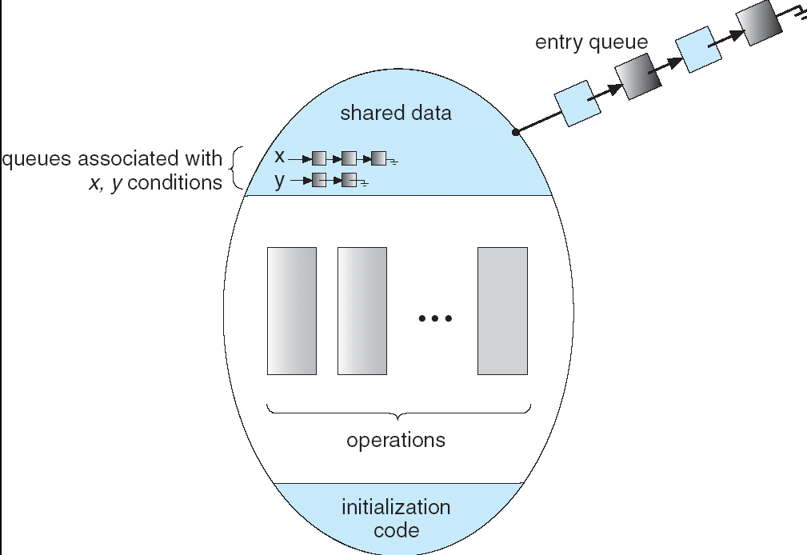
Monitor with Condition Variables
Notes:
100

